Slide 1




BANK LOAN
REPORT
SQL & Tableau Dashboard

Slide 2
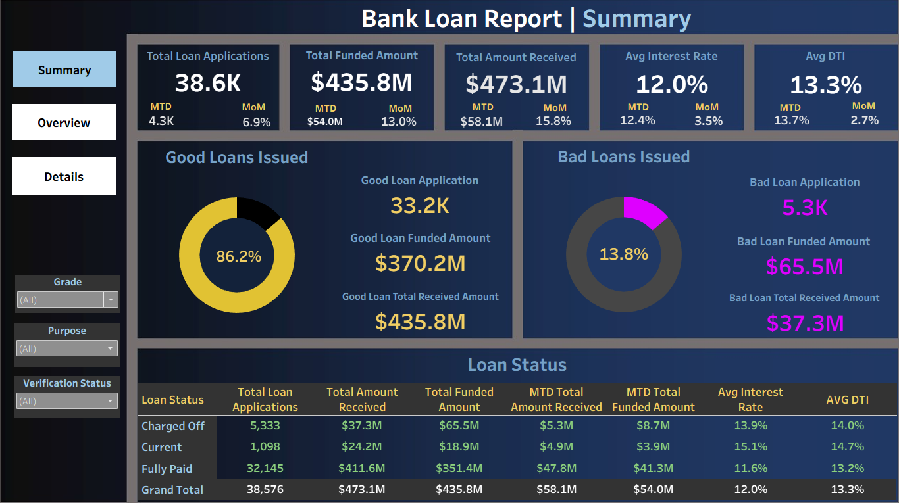

Slide 3
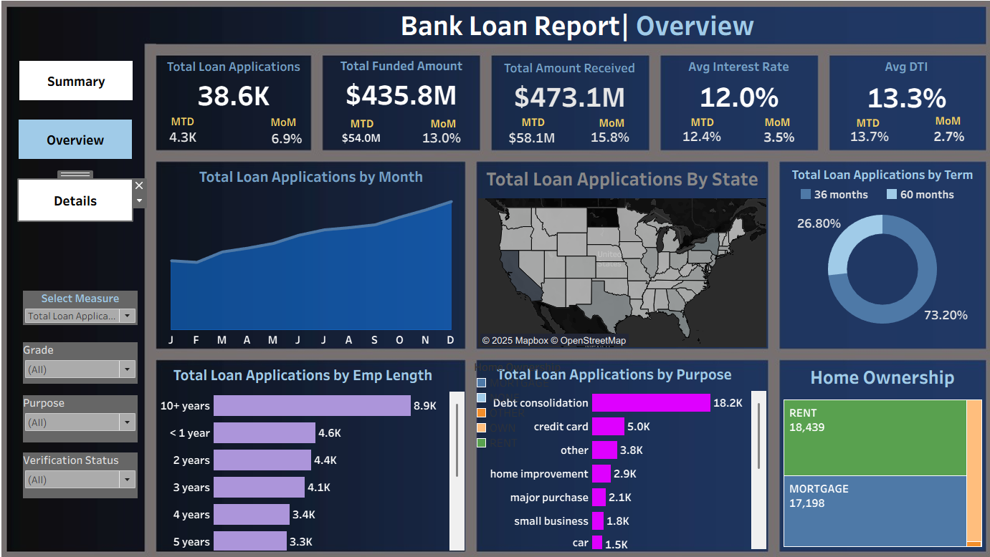

Slide 4
